Slide 1

Ontology, Terminology and Natural Language
Stefan Schulz^{1,2}
¹Institute for Medical Informatics, Statistics and Documentation, Medical University of Graz, Austria ²Averbis GmbH, Freiburg, Germany

Slide 2
Motivation
Ontologies depend on precise terminology. Natural language is ambiguous, but terminologies enforce consistency
Domain ontologies
If seen as a theory of types of domain entities, their elements need to be linked to natural language terms used by denoting those entities
If seen as specifications what terms mean in a shared way, their elements need to be linked to these natural language terms (or groups thereof)
Domain terminology systems (thesauri, vocabularies, lexicons)
Collect and describe lexical items (words, multiword expressions) in terms of
Synonyms, broader / narrower terms, translations
Grammar, morphology
Free-text definitions to standardize meanings
Preferred terms / labels: unambiguous, self explaining, not necessarily "popular"

Slide 3

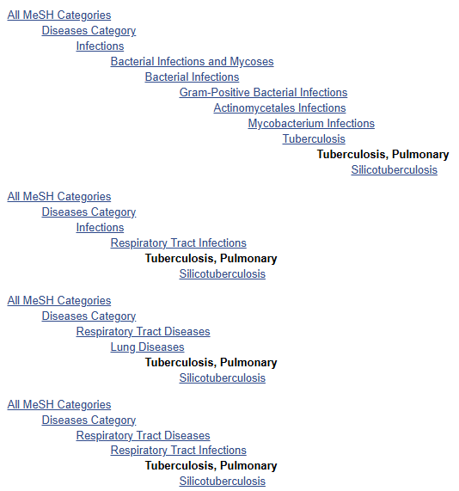
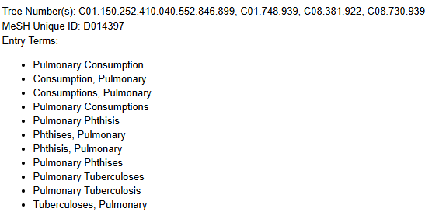
Example: MeSH
https://www.ncbi.nlm.nih.gov/mesh/

Slide 4

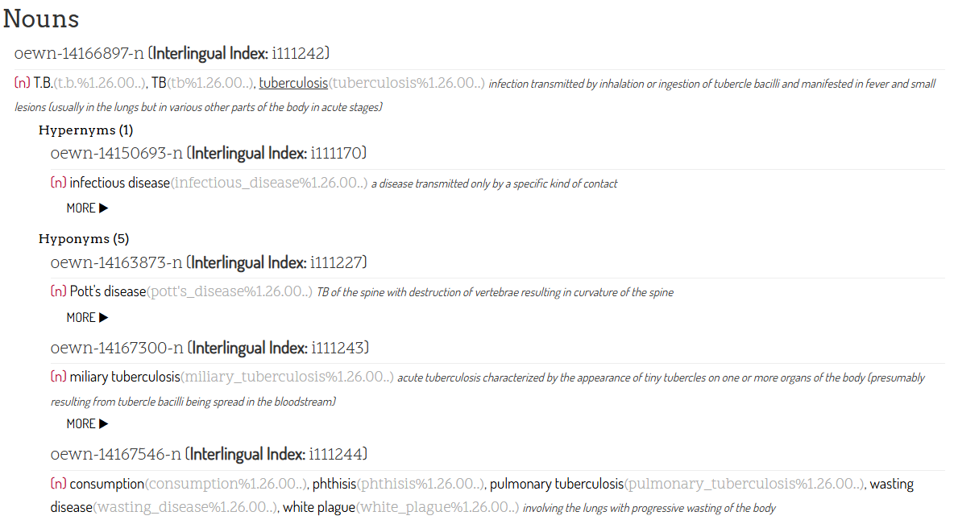
Example: WordNet
https://en-word.net/

Slide 5


Bringing ontology and terminology together: Example: SNOMED CT
Ontology: Description of the domain
Terminology: Description of the domain language
SNOMED CT concepts
Classes
Attributes (relations)
(Poly)Hierarchies
Axioms
Relationships (Triples +)
OWL expressions
Transferrable to EL++
Mappings
SNOMED CT terms
Synonyms
Preferred terms
Fully specified names
Descriptions
Terms + Concept ID
Free text definitions
SNOMED IDs
domain knowledge
linguistic knowledge

Slide 6
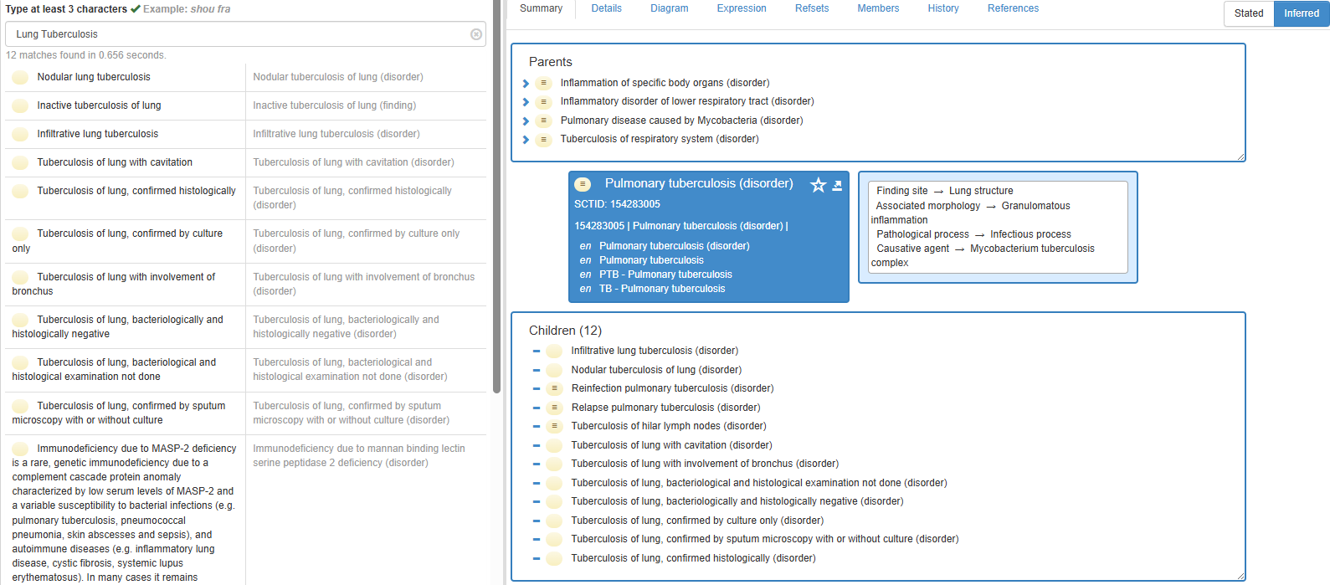

Bringing ontology and terminology together: Example: SNOMED CT (browse)

Slide 7
Terminology of terminology
Units of meaning: concepts, classes, descriptors
Their unique identifiers: IDs, CUIs, Codes, Keys
Their unique labels: "fully specified names" (often rather artificial)
Units of human language: "terms", "names", "synonyms", "entry terms", "lexemes"
Equivalence classes of quasi-synonyms and translations, sometimes hyponyms → 1…* human language terms per unit of meaning
Close-to-user terms important for term retrieval and NLP (natural language processing)
Enumeration of all synonyms and variants prohibitive, particularly with multiword terms
Relations: "predicates", "properties", "relationships"
Binary, often semantically shallow (broader / narrower)
Natural language definitions
Often missing, often rather elucidations than definitions
Important: "term" means unit of language, not unit of meaning

Slide 8
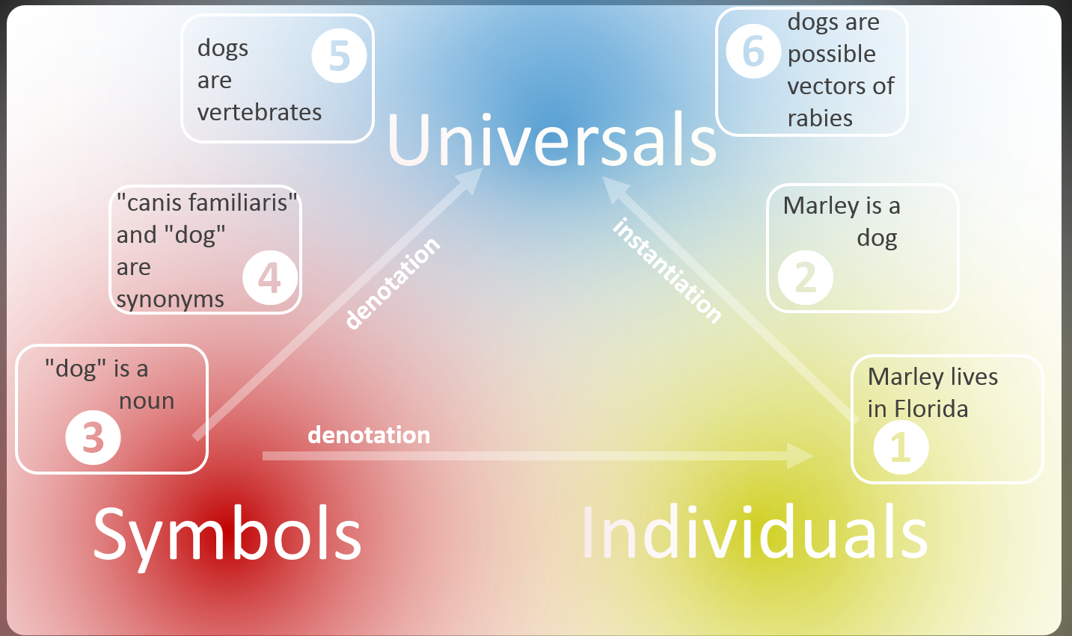
The semiotic triangle
Ontology content: Axioms that are universally true in a domain
Contingent knowledge: What is typical, likely, possible
Symbolic knowledge: Statements about properties and meaning of signs of language, including other symbols and data
Facts (factoids): Statements about concrete entities, their types and their relationships
Charles Kay Ogden and I. A. Richards (1923) The Meaning of Meaning

Slide 9
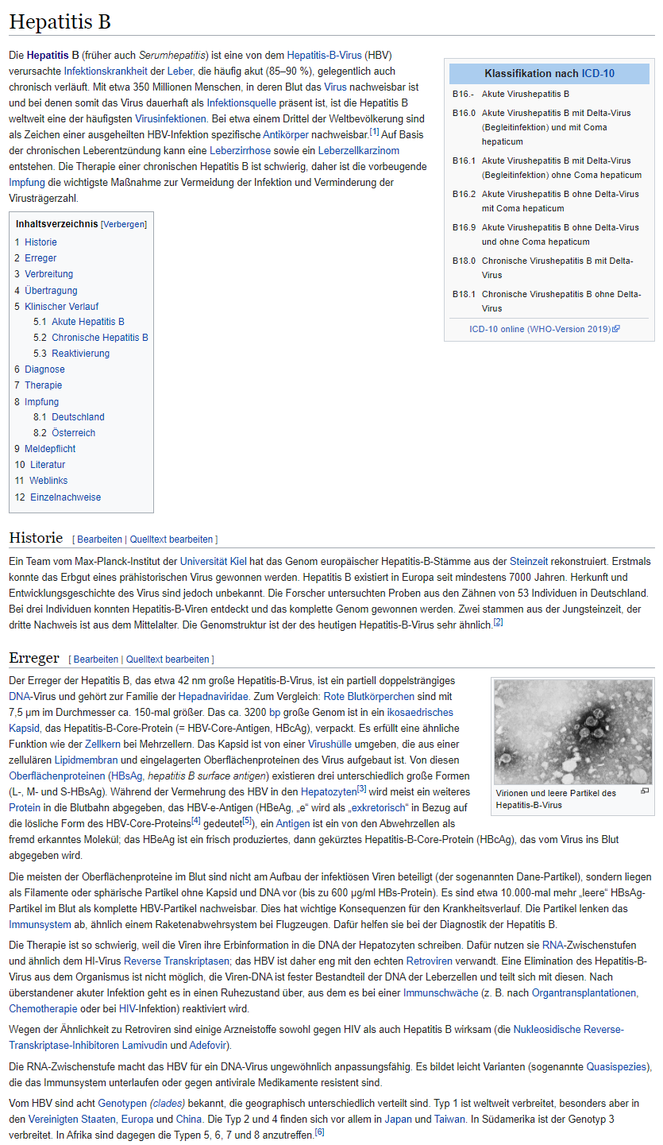
Human language
phonemes
[ħ] , [ɛ], [p]
morphemes
hepat; -itis
words
Hepatitis
multiwords
Hepatitis Typ B
phrases
Das Hepatitis-B-Virus
Das Hepatitis B-Virus Typ B wird hauptsächlich über das Blut übertragen.
sentences
paragraphs
Die Hepatitis-Viren Typ B (HBV) und C (HCV) werden hauptsächlich über das Blut übertragen. Das Injizieren von Drogenkonsumenten und Patienten, die kontaminiertes und nicht wegwerfbares chirurgisches Material erhalten, gehören zu den größten Opfern
document

Slide 10
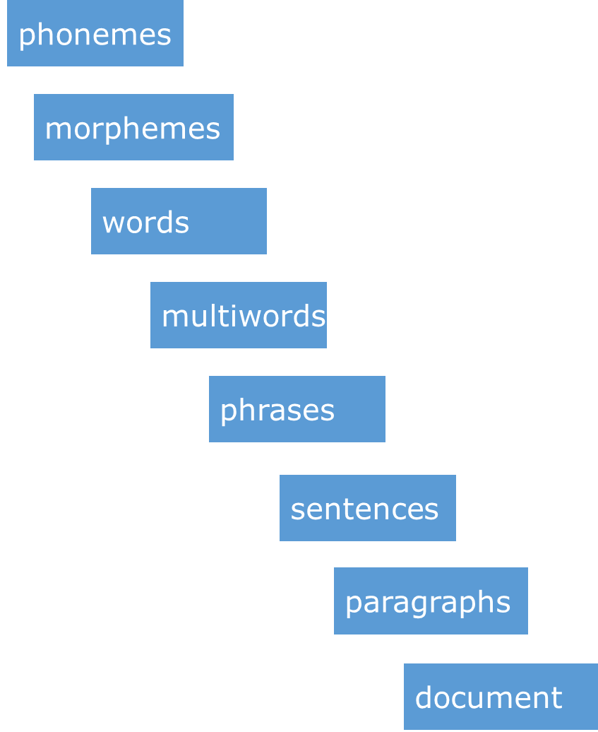
Human language
Human language
High complexity at all levels
Synonymy, polysemy
Highly variable syntax – same meaning:
Lymphozyteninfiltration (compound noun)
lympozytäre Infiltration (adj + noun)
lympozytär infiltriert (adv + verb)
durch Lymphozyten infiltriert (prep + noun + verb)
lymphozyteninfiltriertes (adj)

Slide 11
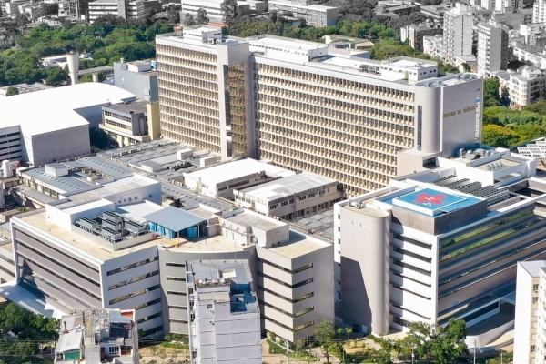

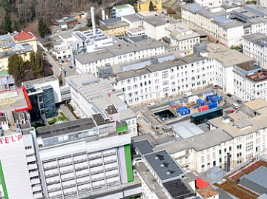

Informal working languages, e.g. clinical language
Porto Alegre Brazil
Graz Austria
Paciente G1PO, IG de 38 sem 4 dia(s), TS A+, interna por bolsa roita há mais de 18hs, recebendo penicilina. Evolui para Parto Eutócico com episiotomia em 27/06/2007 22:24 hs. Nasce RN APGAR 10/10, MASC, 3060 G. Exames: Toxo IGG e IGM neg VDRL neg EQU neg UROC: ausência de crescimento bacteriano. Hemograma 198mil plaq; Hb 13,1; LT 12,5 (75% seg) Em condições de alta, amamentando, útero contraído, lóquios fisiológico, sinais vitais estáveis, FO com bom aspecto. Recebe as orientações abaixo. ORIENTAÇÕES NA ALTA: # AMAMENTAÇÃO EXCLUSIVA POR 6 MESES; # TOMAR AS MEDICAÇÕES PRESCRITAS (SULFATO FERROSO 300MG 3X/DIA POR 90 DIAS, LONGE DAS REFISÇÕES, COM SUCO DE LARANJA; PARACETAMOL 750 MG 6/6HS SE DOR); # ORIENTO ANTICONCEPÇÃO; # RETORNAR À EMERGÊNCIA DESTE HOSPITAL SE FEBRE, SANGRAMENTO AUMENTADO OU OUTRAS INTERCORRÊNCIAS. # NÃO É NECESSÁRIO RETIRAR OS PONTOS. # LAVAR FO 3X/DIA COM ÁGUA E SABÃO DE GLICERINA.
* Anamnese und klinische Symptomatik
Stat. Übernahme vom LKH Fürstenfeld wegen neuerlicher Dyspnoe bei bek. dil. CMP u hochgr. MINS zur CA und Mitraclip /erztransplant Evaluierung. Bei dem Patienten besteht der St.p. 2x Simdax Therapie im Okt 2013.
* Physikalischer Status
48 jähr.Patient, deutl. reduz. AZ, normaler EZ. Cor: Ht rh, nc, Systolikum mit p.max. über dem Erbschen Punkt mit Fortleitung in die Axila
Pulmo: VA bds., feuchte RGs re>li
Abdomen: BD weich, kein DS
Extremitäten: ausgeprägte Knöchelödeme bds.
Herr DI Max Mustermann wurde aufgrund einer neuerlichen Dyspnoesymptomatik bei bek. dilat. CMP und hochgrad. MINS zur weiteren Evaluierung stat. vom LKH Fürstenfeld übernommen.

Slide 12
Phenomenon | Example | Elucidation
Telegram style | "left PICA stroke, presented to ED after fall" | Incomplete sentences, sketchy style
Colloquialisms | "pothole sign", "snorkel" | Milieu-specific sub-languages
Ad-hoc abbreviations | "infiltr" | Truncation ("infiltrated mucosa")
Ambiguous short forms | "RTA" | "Road traffic accident", "Renal-tubular acidosis"
Short forms of regional or local scope | "LDS Hospital" "St. p." | "Latter-Day-Saints Hospital" (and not "Leak Detection System") "Status post" = "History of"
Conventionalized Latin abbreviations | "V mors can dig V dext" | "Vulnus morsum canis digiti quinti dextri" (in some European languages)
Numeric codes | "45, 46 with crowns", "VI palsy", "2-2-2" | Tooth numbers, cranial nerves, dose frequencies
Terminology codes | "I10" | Often added to disease names, e.g. Hypertension (I10)
Spelling errors, typos | "Diabtes", "Astra-Seneca", "Hipotireose", | accidental (quick typing) or systematic (e.g. 2nd language speakers)
Spelling variants | "Esophagus", "Oesophagus" | e.g. American vs. British English
Single noun compounds | "Ibuprofenintoxikation" | Non-lexicalized long words (in languages such as German, Swedish)
Cryptonyms | "N.coli", "ut aliquid fiat" | To conceal meaning (colon cancer, placebo treatment)
Coordinations | "swelling of the gums and tonsils" | Scope of syntactic head often difficult
Ellipses | ECG: 78/min | Not explicitly stated that it refers to heart rate
Anaphora | (i) "adenoCa rect pN+MX G2 (...). tumor excised in toto" (ii) "no blood in stomach (...). mult mucosal erosions " | (i) "Tumor" coreferential to adenocarcinom described in left context (ii) "mucosal erosions" refined to "erosions of gastric mucosa"
Negations | "No evidence of pneumonia" "Pulmones: nihil", "metastasenfrei" | non-standard, jargon-like, negation particle as prefix or suffixed
Epistemic contexts | "susp MI, DD lung embolism" | suspected diagnosis, differential diagnosis
Temporal contexts | "h/o Covid-19", "Streptokokkenangina 06/16" | "history of" Coarse-grained references to dates (mm/yy)
Other contexts | (i) father: pancreas ca" (ii) "refrained from resuscitation" | (i) family history (ii) plans not executed

Slide 13
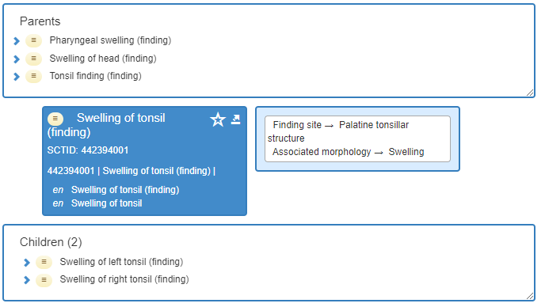
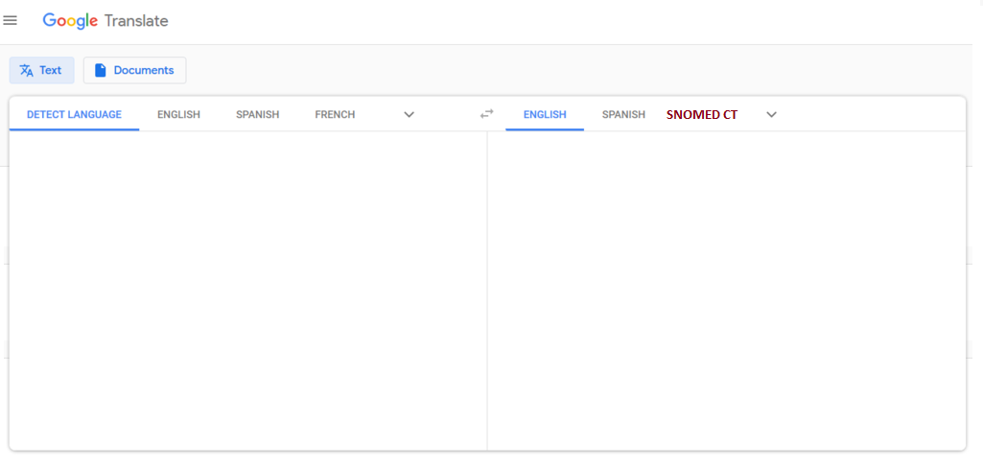
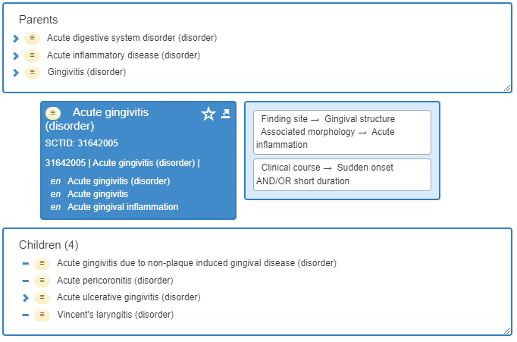
Desideratum: narrative data → ontology-based data
Physical examination on admission revealed purpura of the upper and lower extremities, swelling of the gums and tonsils, but no symptoms showing the complication of myasthenia gravis. Hematological tests revealed leucocytosis: WBC count 68 700/µl (blasts 11.5%, myelocytes 0.5%, bands 2.0%, segments 16.0%, monocytes 65.5%, lymphocytes 4.0%, atypical lymphocytes 0.5%), Hb 7.1 g/dl (reticulocytes 12%) and a platelet count of 9.1 × 104/µl. A bone marrow aspiration revealed hypercelllar bone marrow with a decreased number of erythroblasts and megakaryocytes and an increased number of monoblasts

Slide 14
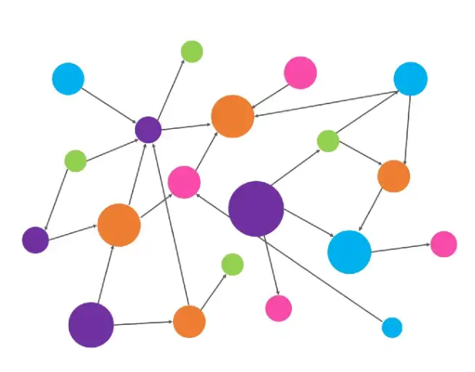
Representation of narrative data as knowledge graphs rooted in ontologies
QUERY
Physical examination on admission revealed purpura of the upper and lower extremities, swelling of the gums and tonsils, but no symptoms showing the complication of myasthenia gravis. Hematological tests revealed leucocytosis: WBC count 68 700/µl (blasts 11.5%, myelocytes 0.5%, bands 2.0%, segments 16.0%, monocytes 65.5%, lymphocytes 4.0%, atypical lymphocytes 0.5%), Hb 7.1 g/dl (reticulocytes 12%) and a platelet count of 9.1 × 104/µl. A bone marrow aspiration revealed hypercelllar bone marrow with a decreased number of erythroblasts and megakaryocytes and an increased number of monoblasts

Slide 15
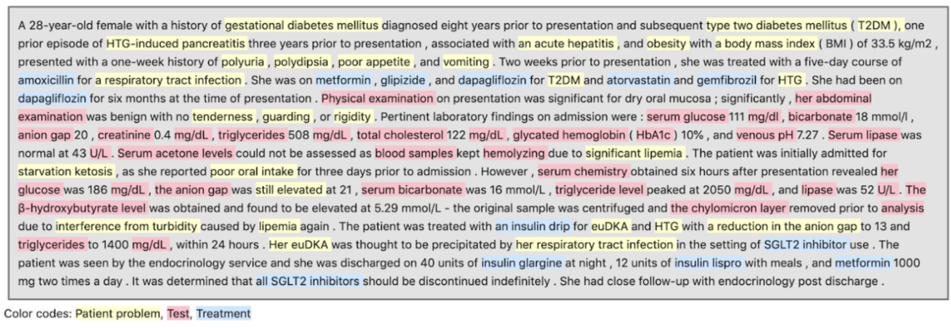
Natural language processing (NLP) tasks and challenges
Entity recognition: identify spans in text and assign some semantic type
Entity normalization / term grounding: assign one or more codes from a CV
Disambiguation: chose the correct code for a mention in text
Lexical challenges
"Amputation": Patient problem or treatment?
"Potassium": Lab parameter or drug?
"Emphysema" = "Lung emphysema"
"Cancer" != "Lung cancer"
"Diclophenac" = "Diclofenac", "Oesophagus" = "Esophagus"
"Hepatectomy" != "Hepatotomy"
"Type 2 diabetes" = "Type 2 diabetes mellitus"
"Diabetes mellitus type 1 != Diabetes mellitus type 2
(beta blocker after) MI != (valve replacement due to) MI
Creation and Maintenance of domain lexicons covering clinical jargon in the local natural language (interface terminologies)
Linking interface terms to coding systems like SNOMED CT and ICD-10
Support fuzzy term matching and disambiguation by algorithms and language models

Slide 16
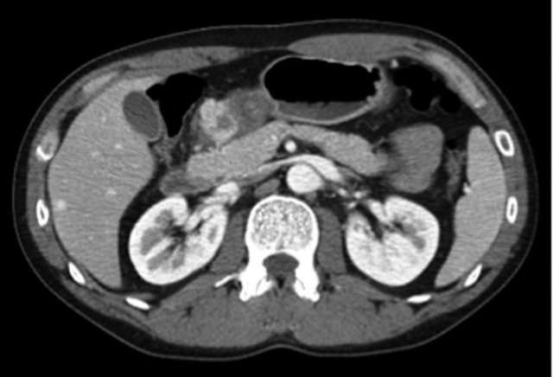
Knowledge graph construction by exploiting the axiomatic structure of the target ontology
Pylorus and superior duodenum: Edematous thickening. Diagnosis: ulcer.
Leveraging entity recognition and normalization…

Slide 17
Anaphoric references (bridging anaphora)
Pylorus and superior duodenum: Edematous thickening. Diagnosis: ulcer
i₁
i₂
i₃
i₄
i₅
i₆
7196007 |Suggestive of (attribute)|
429040005 | Ulcer (disorder)|

Slide 18
Pylorus and superior duodenum: Edematous thickening. Diagnosis: ulcer
i₁
i₂
i₃
i₄
i₅
i₆
439401001 |Diagnosis (observable entity)|
429040005 | Ulcer (disorder)|
267038008 |Edema (finding)|
263899003 |Thickened (qualifier value)|
280119005 |Pyloric structure of stomach (body structure)|
56734009 |Structure of superior portion of duodenum (body structure)|

Slide 19
Pylorus and superior duodenum: Edematous thickening. Diagnosis: ulcer
'Finding site'
i₁
i₂
i₃
i₄
i₅
i₆
‘Inheres in'
439401001 |Diagnosis (observable entity)|
429040005 | Ulcer (disorder)|
267038008 |Edema (finding)|
263899003 |Thickened (qualifier value)|
280119005 |Pyloric structure of stomach (body structure)|
56734009 |Structure of superior portion of duodenum (body structure)|

Slide 20
'Finding site'
Pylorus and superior duodenum: Edematous thickening. Diagnosis: ulcer
i₁
i₂
i₃
i₄
i₅
i₆
439401001 |Diagnosis (observable entity)|
429040005 | Ulcer (disorder)|
267038008 |Edema (finding)|
263899003 |Thickened (qualifier value)|
280119005 |Pyloric structure of stomach (body structure)|
56734009 |Structure of superior portion of duodenum (body structure)|

Slide 21
'Finding site'
Pylorus and superior duodenum: Edematous thickening. Diagnosis: ulcer
i₁
i₂
i₃
i₄
i₅
i₆
439401001 |Diagnosis (observable entity)|
429040005 | Ulcer (disorder)|
38848004 | Duodenal structure (body structure)|
267038008 |Edema (finding)|
263899003 |Thickened (qualifier value)|
280119005 |Pyloric structure of stomach (body structure)|
56734009 |Structure of superior portion of duodenum (body structure)|
'Finding site‘ some
51868009 |Ulcer of duodenum (disorder)|
'Finding site‘ some
39204006 |Pyloric ulcer (disorder)|

Slide 22


Resolve competing semantic representations
unconfirmed
unconfirmed
390926006 |Suspected gallstones (situation)|
235919008 |Gallbladder calculus (disorder)|
313413008 |Calculus finding (finding)|
3578005 |Structure of body of gallbladder (body structure)|
unconfirmed
56381008 |Calculus (morphologic abnormality)|
41769001 |Disease suspected (situation)| :
{ 246090004 |Associated finding (attribute)| = 235919008 |Gallbladder calculus (disorder)|,
408729009 |Finding context (attribute)| = 415684004 |Suspected (qualifier value)| }
3578005 |Structure of body of gallbladder (body structure)|
Use logical reasoning to recognize equivalence?

Slide 23
Concept mapping is not enough
Ontology, e.g. SNOMED CT
incisional hernia
operation room
liver transplant
herniorrhaphy
operation
operation
exists
doesn’t exist
reference to a plan
reference to a suspended plan
exists
reference to a plan
NOT referring to the same patient
reference to a new plan
not yet executed
Patient with incisional hernia admitted for herniorrhaphy, but operation was suspended because operation room was urgently needed for liver transplant. Discharged with orientation and rescheduled operation.

Slide 24
Data, reality and context
Complex relationship between healthcare data and reality
Mention of drug in EHR
Recommended by hospital doctor
Prescribed by general practitioner
Purchased by patient
Taken by patients
Mention of disease
Suspected vs. confirmed
Disease or cause of death
Disease != Diagnosis !
There are undiagnosed diseases
There are wrong diagnoses

Slide 25
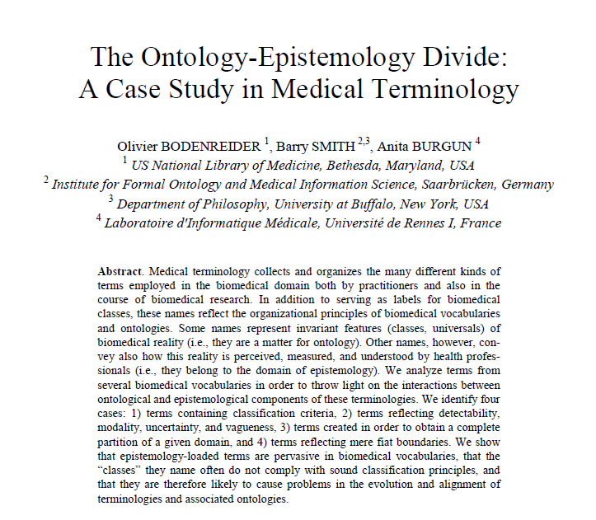
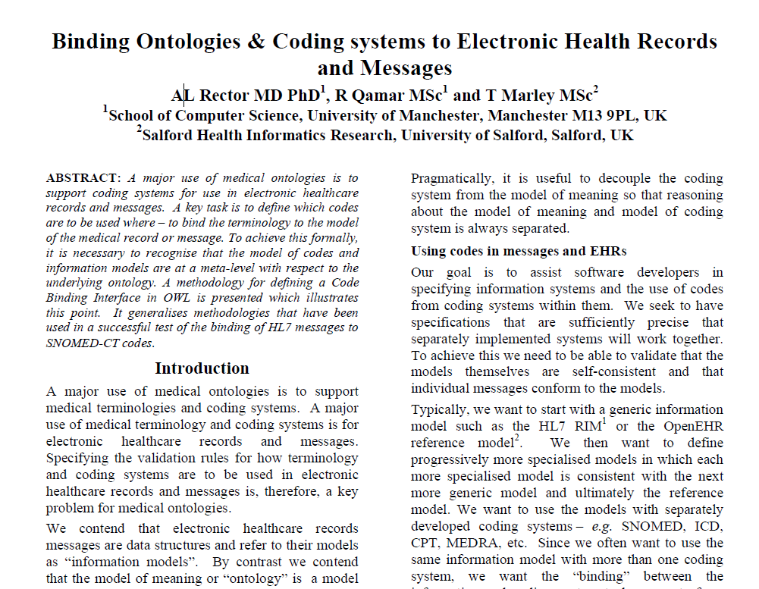
Seminal papers
Bodenreider O, Smith B, Burgun A. The Ontology-Epistemology Divide: A Case Study in Medical Terminology. Form Ontol Inf Syst. 2004;2004:185-195.
Rector AL, Qamar R; MarleyT. Binding ontologies and coding systems to electronic health records and messages. Applied Ontology, 2009 (4.) 1, 51-69.

Slide 26
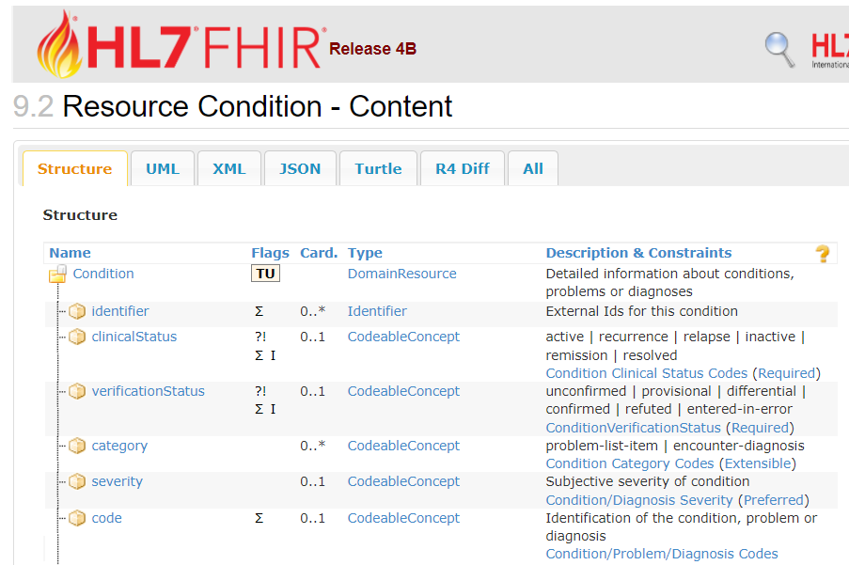
Interface between information models and ontologies
Example: "suspected active appendicitis"
Epistemology:
Knowledge / context
Model of use
Ontology
Entity types and their properties
Model of meaning
E.g. SNOMED CT codes
HL7 value sets
https://hl7.org/fhir/codesystem-condition-clinical.html #condition-clinical-active
https://hl7.org/fhir/codesystem-condition-ver-status.html #condition-ver-status-unconfirmed
http://snomed.info/id/74400008

Slide 27
I – Building resources: language specific dictionaries and linking to ontologies
Example: German interface terminology for SNOMED CT
[*]Schulz S, Hammer L, Hashemian-Nik D, Kreuzthaler M. Localising the Clinical Terminology SNOMED CT by Semi-automated Creation of a German Interface Vocabulary. Proceedings of the LREC 2020 Workshop on Multilingual Biomedical Text Processing (MultilingualBIO 2020). Luxembourg: European Language Resources Association; p. 15-20. 2020

Slide 28
Building resources: language specific dictionaries and linking to ontologies
Manual creation / maintenance
Language productivity / compositionality: impossible to collect all variations in a dictionary, as well as all ambiguous readings
Community processes (crowdsourcing)
The potential of machine learning
Synonym detection
Machine translation
Spelling correction
Short form resolution
Word sense disambiguation
Safe entity recognition and normalization still a long way to go
Clinical training data required Still require human review

Slide 29
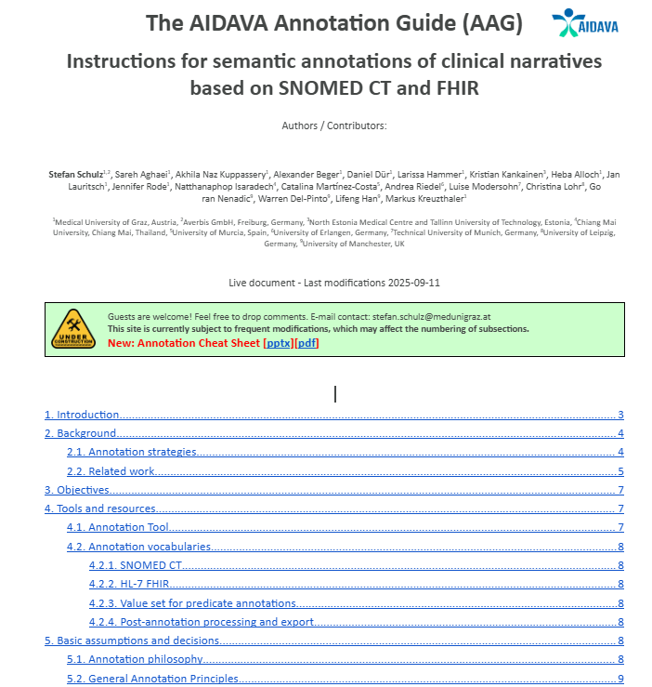
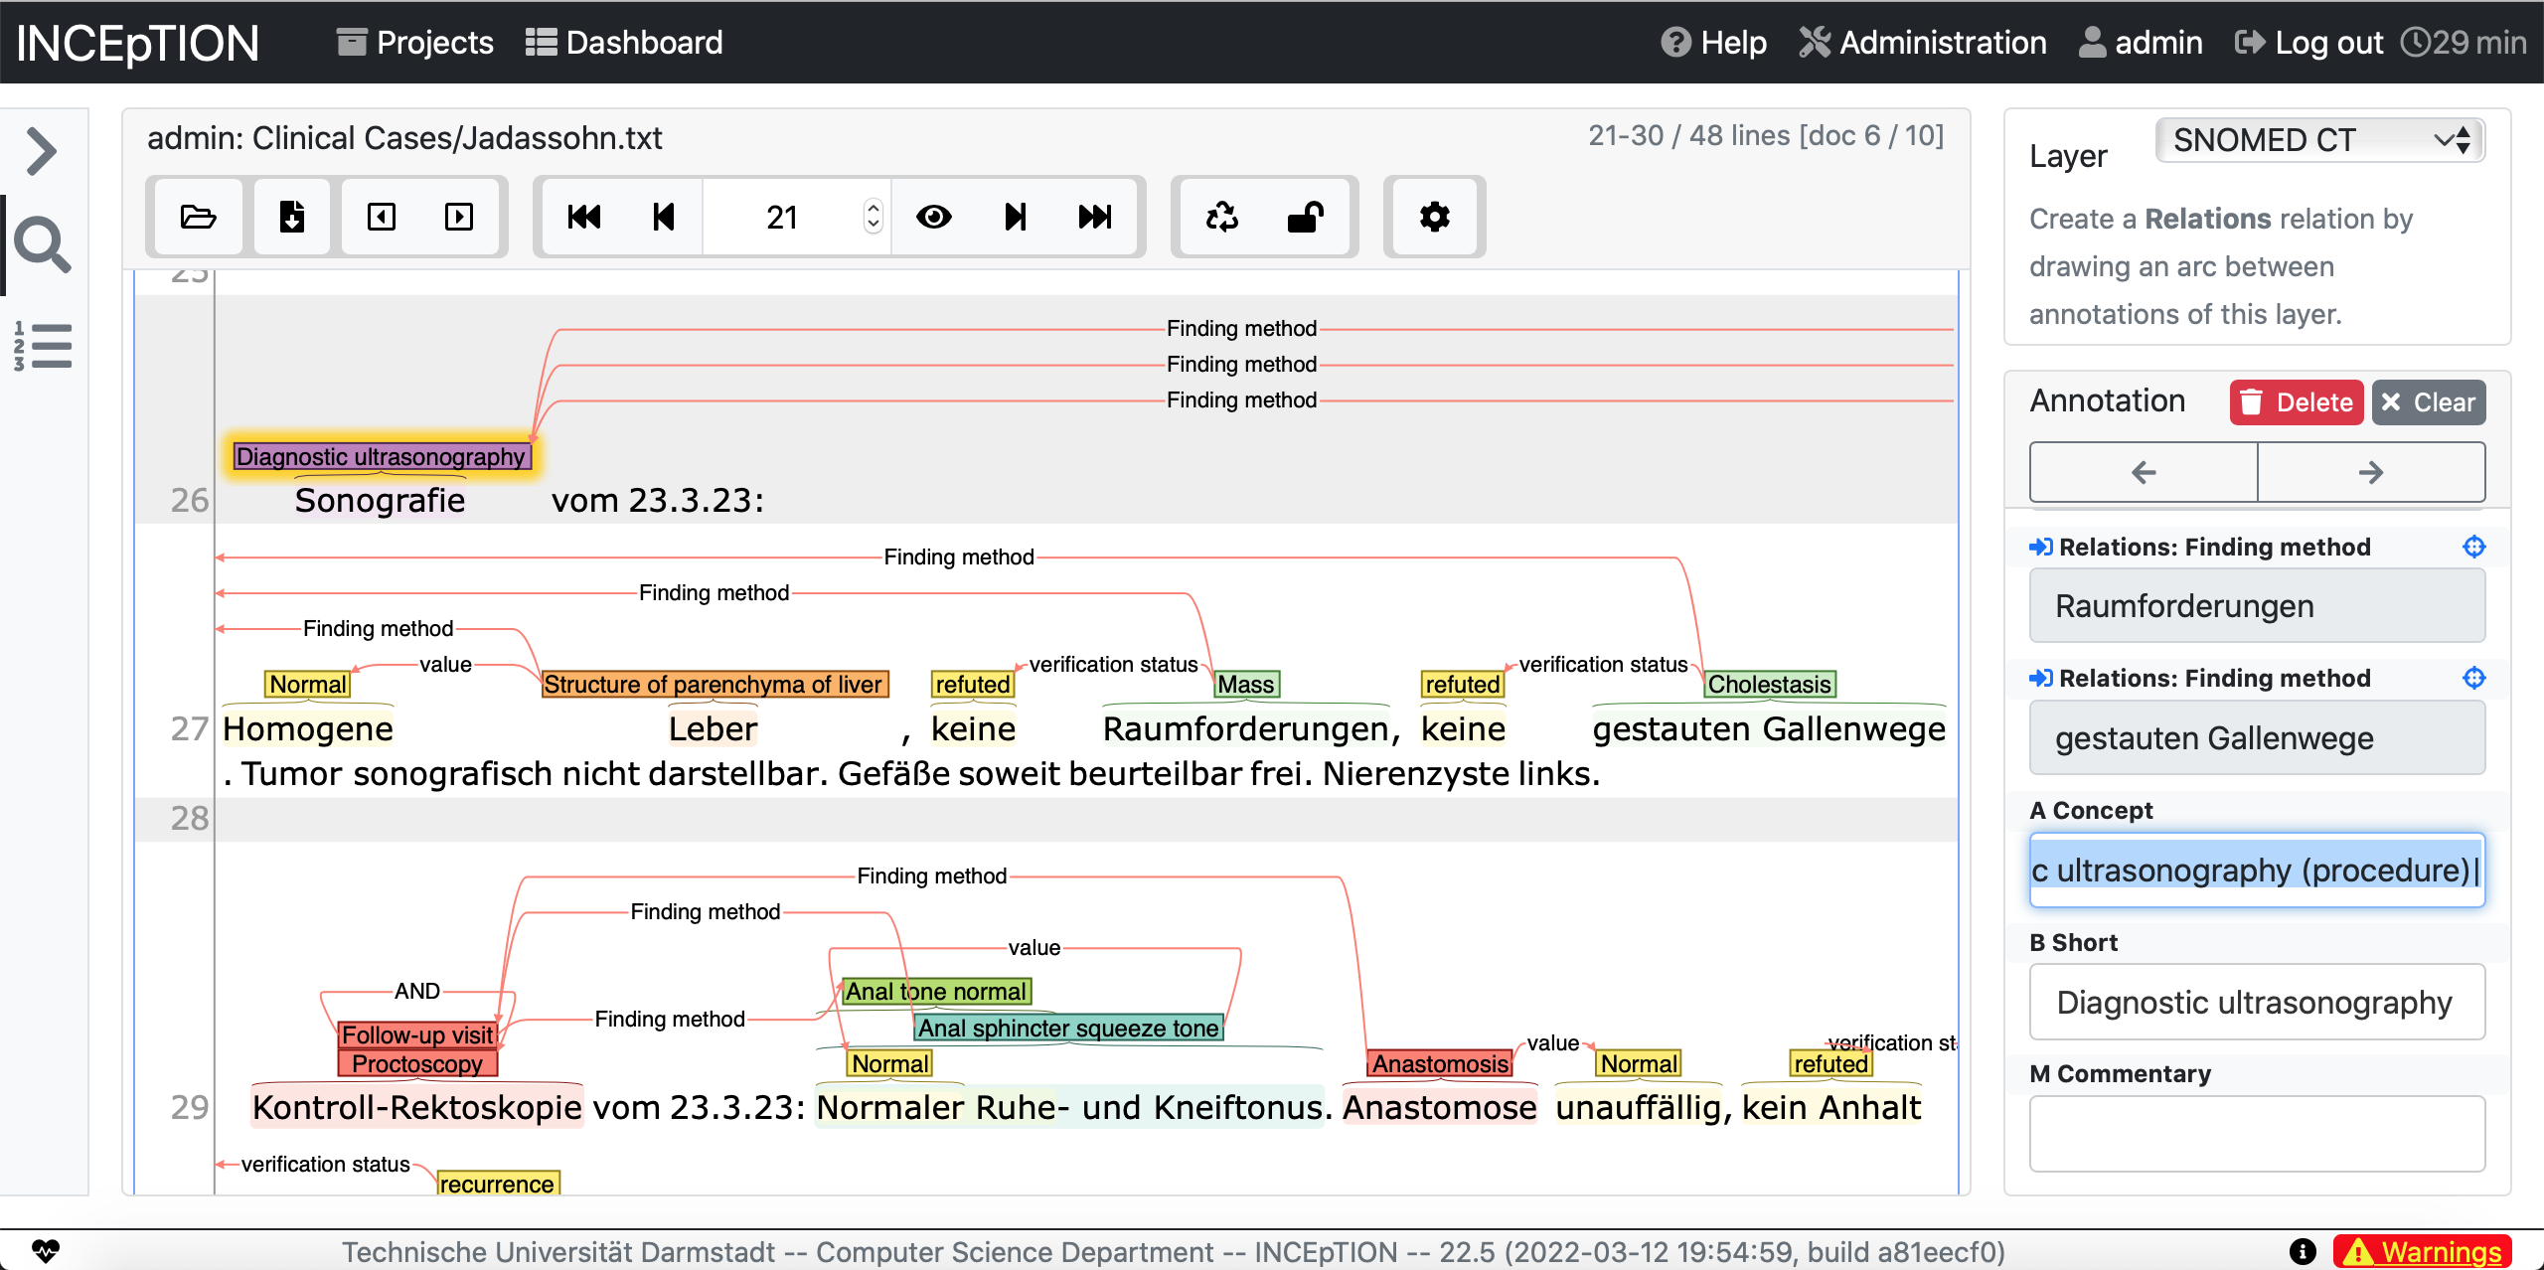

II – Building resources: annotated domain corpora
Annotations should use the same semantic resources as expected for the processing of real data: in our case SNOMED CT and FHIR

Slide 30
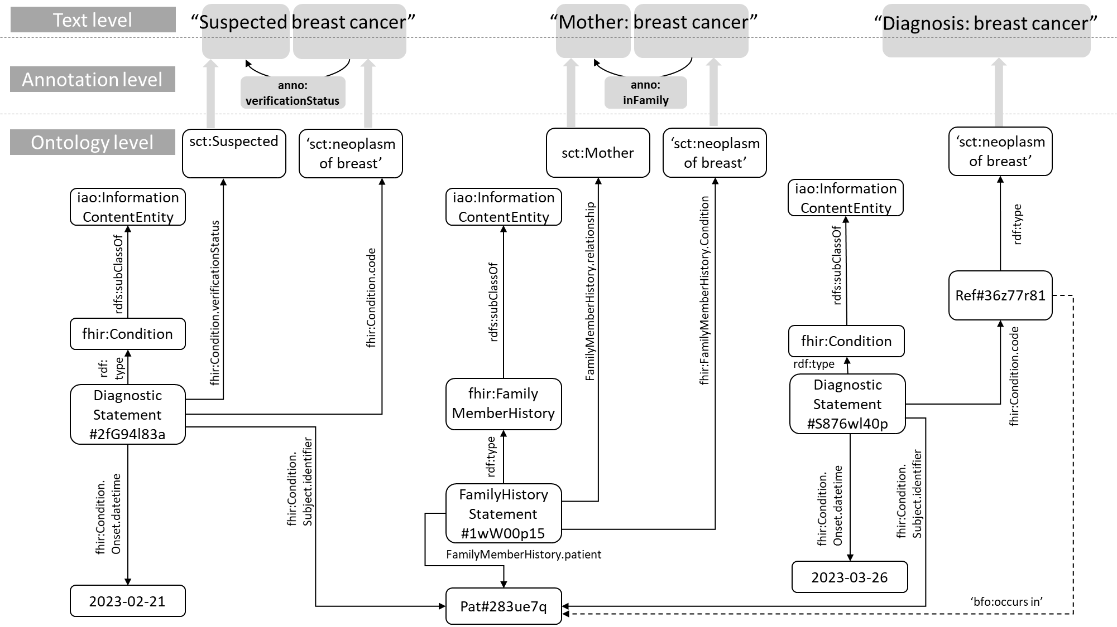
From annotation to ontology-based knowledge graph

Slide 31
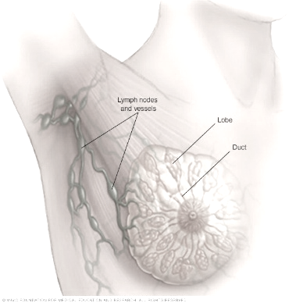
Example coreference
t₁
t₂
t₃
t₄
713609000 |Invasive carcinoma of breast (disorder)| AND
126926005 |Neoplasm of breast (disorder)|
254837009 |Malignant neoplasm of breast (disorder)|
278054005 |Lobular carcinoma of breast (disorder)|
278054005 |Lobular carcinoma of breast (disorder)|
rdf:type
rdf:type
rdf:type
rdf:type
NoB34u73axn4us
owl:sameAs
MoBkj88935elp
owl:sameAs
LCBrrp009g65t
owl:sameAs
ILCB4tz5pplkll
lobular carcinoma of breast
Invasive lobular carcinoma of breast

Slide 32

Improving results using LLMs
Shortcomings of established concept recognition approaches:
Out-of-dictionary expressions
Spelling errors
Ellipses, co-ordinations, anaphora
Tabular content
Hidden negations
Brand names
Itemization / enumeration
"Document cleansing" using LLMs
Rewriting document, resolving abovementioned issues
Normalization of syntax – transformation into Subject-Predicate-Object triples
Prompting exercise
Results

Slide 33
Conclusion
The medical domain is rich of semantic resources, but heterogeneous
Biomedical ontologies are rich in axioms, e.g. SNOMED CT
Most relevant information is in clinical narratives
Clinical language is particularly hard to normalize and disambiguate
Much needed:
Multilingual terminology resources
Annotated corpora for training models and benchmarking implementations
Scientific challenges for comparing and validating
Safe access to clinical data extracts for research
Combination of symbolic with probabilistic / neural methods: to explore

Slide 34
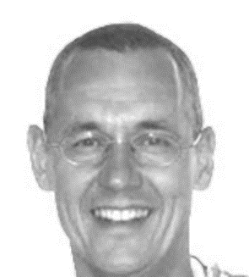
Questions?
Stefan Schulz: stefan.schulz@medunigraz.at
http://purl.org/steschu

Slide 35
Annex

